Slide 1

Project Daybreak
1 SEPTEMBER – 30 OCTOBER 2026
Getting a release from stage to production in one day
Friday 28 August 2026 · Product and Development
Notes:
Hour has one job: people leave having put their name on something. Don't re-read Monday's Teams post — the dates and the link went out there already.

Slide 2

What we found
PART ONE
One shared shaping day with the whole department, then four more sessions with the core team.
Notes:
Thank the room first. Most of what we know came out of that shaping day, and a lot of it wasn't written down anywhere.

Slide 3
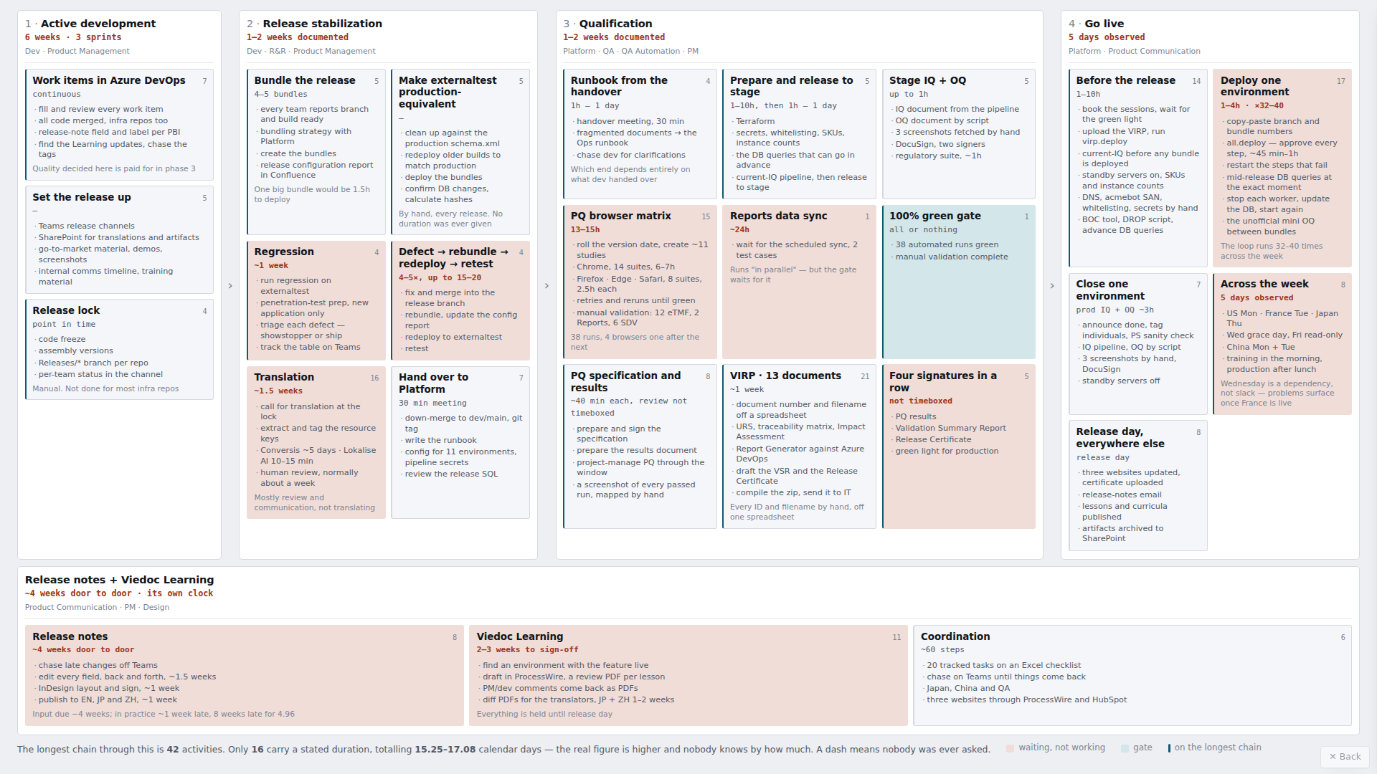
201 activities in a release. 183 of them manual.
201
activities, mapped end to end
183
of them manual
301
dependencies between them
104
hand-overs between teams
37
carry a duration we can add up
Every activity, who does it, how long it takes, whether it's manual. The longest chain through it is 42 activities. The second tab on the shared page is where we're heading.
Notes:
Have the shared line open in a browser tab and show it. Don't walk it step by step — the invite promised a quick pass.

Slide 4
From the test lead's approval to live in all four regions — inside 24 hours.
The clock
Starts when regression is approved and the release is free to move.
Stops when the last production environment is live and qualified.
No release has ever been timed. 4.96 is stamped at every step in week 1, so there is a baseline to beat.
The prize
Every release. 183 of 201 activities are manual today and 104 hand work between teams. Fewer steps, fewer hand-overs, reproducible, less to get wrong by hand.
Hotfixes and security patches are the sharpest case. No separate path — a hotfix runs the same chain, and it is smaller because a hotfix is smaller. One package in the manifest instead of 39.
The proof
Five drill releases, the last one timed.
There is no real release inside the window: 4.96 ships in week 1 on the old process, and 4.97 is locked from 8 September.
4.96 is the only release we will measure the same way we measure the drills. Older releases give a rough comparison, not the same clock.
Regression testing itself is out of scope and outside the clock. What changes is the environment it runs on, and that its result becomes an artifact.
Notes:
The 24 hours is a capability, not a promise to ship that way. Staggering regions afterwards is a product decision. The prize is not only hotfixes — 183 of 201 activities are manual today and that is what changes. On the baseline: no release has ever been timed against this clock, so 4.96 gets stamped at every step in week 1. If asked 'can we not release until November': 4.96 goes out first week of September, and hotfixes go whenever they need to.

Slide 5

Where we're going
PART TWO
Seven stages, from a merge into main to production in all four regions.

Slide 6
The chain
28 pipelines. 25 of them run during a release. A person queues one thing.
Build
per repo, continuously
Release
readiness
Release
creation
Regression
testing
externaltest
Validation
and approval
fr-stage
Production
rollout
4 regions, 8 instances
Close
pkg.pr-gate
pkg.build
release.readiness
release.docs
release.create
release.branch
env.deploy · env.qualify
test.automated
env.qualify · compile
promote · virp
release.rollout
release.close
Artifacts, migration scripts, the DB hash, the unit test report
Are we ready for 4.99? Validate, generate, change nothing
Label, pin every version, publish the manifest, open the down-merge PR
Deploy, qualify, run the automated suite. Then regression, then the test lead approves
IQ, OQ, smoke, PQ, regulatory. PM then QA approve in Teams. The VIRP is built
Training then production in each region — eight environments, each deployed and qualified
Record what is now live. The next release starts by reading it
The loop closes
· A release ends by writing down what is now live, and the next one starts by reading it. Nothing re-derives the current state.
· The release label is the only input. Every pipeline after release creation takes the label and resolves everything else from the manifest.
What stays human, on purpose
· The test lead's judgement that regression is complete.
· The PM and QA approvals — the two decisions we keep, with everything around them automated so the decision is the only thing left.
· Reviewing a release note, locking release dates, and deciding what goes in a release at all.
Notes:
Don't read the boxes out. Each box is a phase, with the environment underneath it. Three things to land: qualification is part of deploying, the loop closes, and the release label is the only input anything downstream takes.

Slide 7
What's actually different
One package
One release label. Every version pinned. The same package goes to every environment — stage, training, production, all four regions.
One repository runs it
Everything the release does lives in Delivery — the pipelines, the declarations they read and the scripts they run. Nothing points back at Infrastructure.
Three blocks, on slots
Deploy, verify, switch. A block cannot switch until it is green, and the next cannot start until the one before it is live. Deployment and release come apart.
Qualifying is part of deploying
Every environment produces its own IQ, OQ and smoke test, every time. There is no parameter to skip it.
Two approvals
PM, then QA, in Teams — instead of four signatures in a row. Production refuses any package that has not been promoted.
Fewer manual steps and checks
183 of 201 activities are manual today and 104 hand work between teams. Verification stops being a person confirming and becomes an artifact the pipeline produces.
Generated means final
Machine identity — what produced it, from which run, at what time. No hand edits. Filed by the pipeline that made it.
One source of truth
Azure DevOps. Every generated document traces to a field in a work item. A correction is made at the source and the document is regenerated — never edited.
Notes:
Eight things. The one people push back on is three blocks on slots: an application can't assume everything around it moved at the same time. Oscar is taking breaking changes to the tech leads as a question, not a rule.

Slide 8
Three rules we're building to
1
2
3
Build beside, never on top
Everything lands in Delivery, a new repository. Nothing modifies a pipeline a release depends on. Where we reuse code we copy it — no shared template repository, no cross-repo includes, nothing pointing back at Infrastructure.
The old path stays live until a real release has gone out on the new one. A hotfix may have to go out mid-project, and every mistake has to be reversible.
All 28 pipelines exist in week 1
Every one of them is created as a shell. It runs, it prints what a person does today, and it hands off to the next one. The chain runs end to end from the first week even though almost none of it is real yet.
Teams replace one shell at a time, and the manual step stays inside the pipeline until the automation is ready to take its place. No work stream blocks another from starting.
We own the picture, you own the how
The core team defines what each pipeline is for and what it must produce.
The team that owns it decides which checks that means and how they are written.
Notes:
Rule 1 is the answer to 'what if you break the release'. The repository is Delivery — it exists and the four documents are in it. Nothing changes on 1 September: we build beside the current process, and the old path stays live until a real release has gone out on the new one.

Slide 9

The work
PART THREE
Fourteen work streams. Six of them have nobody's name on them.

Slide 10
Fourteen work streams
Owned by the teams that own the code. The core team owns the picture and the release pipelines themselves.
Run test cases on dev environments
Daniel B.
Worker → Container Apps
Heartbeat
PR-to-main validation
OPEN
1
5
10
Trunk-based — main is always releasable
Oscar + tech leads
Replace the Report Generator
OPEN
Release pipelines end to end
Core team — hands-on
1b
6
11
PQ
Ganesh / Daniel / Surya
Smoke test
OPEN
Write down what “done” means
QA + tech leads
2
7
12
Infrastructure as code, in Bicep
Sebastian / Platform
IQ / OQ
Phoenix — not confirmed
Every document traced to its source
OPEN — needs QA
3
8
13
PDF generation
Heartbeat
Release notes
OPEN
What every package publishes
OPEN
4
9
14
Notes:
Six are open. Don't dwell here — this is set-up for the next slide.

Slide 11
Six need an owner. Today.
Sign up for the one you want — we would rather that than assign it.
6
Replace the Report Generator
Five documents out of one parameterized pipeline. Retires the Report Generator VM and the document-numbering spreadsheet.
by 18 Sep
your name here
7
Smoke test
A Playwright suite that walks the real user flows through the browser, on every environment, every deploy. Minutes, not hours.
by 2 Oct
your name here
9
Release notes
Generated from the work-item field. Corrections go back into the work item and it is regenerated — nothing is edited in place.
by 18 Sep
your name here
10
PR-to-main validation
One pipeline definition, attached to every product repo. It validates the work items linked to the PR and never checks out the code.
warn 18 Sep
blocks 2 Oct
your name here
13
Every document traced to its source
All 30 documents get a source, a producer and a destination. Needs QA in the room, document by document. Blocks stream 6.
by 18 Sep
your name here
14
What every package publishes
The contract for what a build must produce and how it is formatted, the script that computes the DB hash, then ~39 packages conforming.
by 18 Sep
your name here
More of you than there are boxes? Next is stream 8's endpoint conformance — bringing all 19 declared applications to one OQ contract. It is the largest unassigned piece of work in the plan.
Notes:
The slide to stop on. Read the six, then stop talking and let people volunteer. Expect more teams than boxes; say where the surplus goes before anyone asks.

Slide 12
What changes for every team
Whether or not you take a work stream. Streams 1b, 10 and 14 — three things that live in your own repo. Daybreak specifies them and does not build them.
1b
10
14
Main is always releasable
Everything that lands on main is deployable to production that day. It does change how work reaches main — the merge becomes the last thing you do, not the first, and once it lands it is complete. Not full trunk-based development, and feature branches stay.
Oscar is agreeing it with the tech leads, not announcing it. Week 1.
A PR that isn't release ready can't merge
Work item complete — description, acceptance criteria, test plan, impact, release notes. Test case and test result linked and passed. Feature and epic linked. Ready for translation. Database migrations declared. And the PBI is set to Done automatically on merge.
Warn-only from 18 September, blocking from 2 October.
Your build publishes three more things
Migration scripts, the DB hash where it applies, and the unit test report — alongside the binaries, in the shape the release expects. A change to your own build, not a new pipeline: a build has to check out the product source, so it stays with the source.
Stream 14 owns the contract and the hash script. The change lands in ~39 packages.
Adoption is per package and visible. release.readiness reports which packages still have no DB hash — a number we read at every drill, not a thing anyone chases.
Notes:
This is the part that changes everyone's day, so say it plainly. 1b does change how work reaches main — the merge becomes the last thing you do. Stream 14 is new: nobody owned the package contract itself, only the pipelines that consume it.

Slide 13
Eight weeks, six milestones, five drills
Each milestone after the first carries a drill, and each drill runs more of the same chain for real.
M1 Fri 4 Sep
The skeleton runs
M2 Fri 18 Sep
A release package exists
M3 Fri 2 Oct
externaltest qualifies itself
M4 Fri 16 Oct
The approval is an artifact
M5 Fri 23 Oct
One region, hands off
M6 Fri 30 Oct
The one-day release
Baseline
Drill 1
Drill 2
Drill 3
Drill 4
Drill 5
The repo exists, all 28 pipelines chain end to end, and both ways-of-working agreements are made. 4.96 ships on the old process — and is timed.
A label produces a pinned manifest and a full set of generated documents. Nothing is deployed.
Deployed in block order on slots, and always producing IQ, OQ and smoke. Four-week evaluation.
Stage deployed, fully qualified, promoted by PM then QA in Teams. The VIRP is produced.
A promoted release goes through one region, training then production, and the deployed state is written down.
A person queues one thing and all four regions go out. Timed, against the 4.96 baseline. This is the proof.
How a drill works. Not a real release: a fake product backlog item, a fake technical backlog item and a fake bug, pushed through every step together, including all release documentation, round after round. The same three items go through every drill — the point is the process, and the measurement.
Dev Days are Monday 5 – Tuesday 6 October.
Notes:
Six milestones, five drills, dates set. Dev Days sit between M3 and M4.

Slide 14
Fourteen streams across eight weeks
Preliminary. Six streams have no owner yet, and nobody has committed to a date.
4 Sep
18 Sep
2 Oct
16 Oct
23 Oct
30 Oct
M1
M2
M3
M4
M5
M6
1 Run TC on dev Daniel B.
agreed
1b Trunk-based main Oscar + leads
agreed
2 PQ Ganesh +2
PQ automated
3 IaC in Bicep Platform
provisioned from code
4 PDF generation Heartbeat
done
5 Worker → ACA Heartbeat
done
6 Report Generator OPEN
documents generated
7 Smoke test OPEN
smoke on every deploy
8 IQ / OQ Phoenix?
all 19 conform
9 Release notes OPEN
notes generated
10 PR-to-main validation OPEN
gate blocks
11 Release pipelines Core team
the one-day release
12 What “done” means QA + leads
written down
13 Documents traced OPEN — needs QA
all 30 filed
14 Package publishes OPEN
~39 packages conform
Baseline
Drill 1
Drill 2
Drill 3
Drill 4
Drill 5
The milestone dates are set; the bars are not. Coral has no owner yet. The shaded week is Dev Days, 5–6 October. Stream 6 starts in week 2 — stream 13 walks its five documents first.
Notes:
The same eight weeks with every stream on it. Preliminary — six have no owner and nobody has committed to a date. Two things to point at: the coral bars are the ones that need a name today, and stream 6 starts in week 2 because stream 13 walks its five documents first.

Slide 15
What we're not doing
Named so nobody has to guess. Several of these matter more than things that are in scope — they are out because eight weeks is eight weeks.
Inside the release process, deferred
Regression testing itself — Its own topic, with Daniel B. ~175 person-hours, ~30% of a release
The browser matrix — Its own decision, with Ganesh
Release-note authoring and review — ~60 steps and a review app. Generating them is in scope
Translation, and Lokalise — Target two
Viedoc Learning — Should shift left, needs Rachel and the teams to agree how
Release setup, and the region week — Staggering regions is a business decision
Technical work we could do, and are not
Decommissioning Infrastructure — We copy out of it and stop depending on it
The rest to Container Apps — Designer, Clinic and the others could follow the worker
Buying an orchestration tool — Octopus Deploy raised from experience, dismissed on time
Production container registry — Called very important. On a test subscription today
Full one-click suite provisioning — The Bicep end goal. Larger than this project
ProcessWire tooling, and an MCP for it — Longer than eight weeks. Rachel and Sylvia have discussed it
Three more are tabled rather than out: whether the release-approvals stage survives, whether the release branch survives, and whether the Release Certificate stays. Those get settled with QA.
Notes:
Read this one. It is the slide that stops people assuming their thing is in scope. Regression is the biggest cost line and it is deliberately out.

Slide 16
Where AI comes in
We want to lean on AI wherever it earns its place. Four places it could take real work off us. None of them are closed.
Review what people wrote
Do the acceptance criteria make sense against the test cases? Do the test results actually describe each step? A static gate can only check that a field is filled in.
It is the reason to build PR validation centrally and once, instead of a copy of the YAML in 100+ repos.
Review the whole binder
Eventually, whether a release's documentation holds together as a set — not just that each document exists and each field has something in it.
Nothing else in the plan waits on it.
Prompts are artifacts
They live in the repository and are versioned and reviewed like anything else we ship.
Mechanics are open: an agent installed on the build agent, a pre-built image, or just an API call. Blocking nothing.
Help run a release end to end
An agent that drives the chain: queues what comes next, reads why something failed, restarts that part, and comes to a person only when it needs one.
A release skill plus a release repository is the near-term shape. How far it goes is open.
Notes:
This answers the question somebody always asks. Say out loud that nothing here is decided — it is where the conversation got to on day 4, not a plan. Card four is the orchestrator, and requiring an agent in a regulated process was argued against.

Slide 17

What we need from you
PART FOUR
Work starts Tuesday 1 September.

Slide 18
What we need today
1
Put your name on one of the six
Streams 6, 7, 9, 10, 13 and 14. Pick the one you want — we are not assigning them. Surplus goes to stream 8's conformance work, not to streams that already have an owner.
2
If you're on a long stream, tell us what fits in eight weeks
PQ, infrastructure as code, PDF generation and the worker run the whole project. One question up front — what can you deliver by 30 October — then weekly on track or not.
3
QA in the room for the document walk
Thirty documents, one at a time: what is it for, can we avoid it, what is it generated from. Stream 6's five come first, in week 1 — it cannot write code until they are done. The rest by 18 September. Stream 13 cannot be done by a team alone.
4
Read the plan and tell us what's wrong
PLAN.md §3 is your stream — what lands, when it's done. §4 is what we are deliberately not doing. That is the read for everyone. The other three — pipelines.md, pipeline-specs.md, documents.md — are reference for whoever writes the pipelines. All four are in the Delivery repo, and nothing in them is agreed, which is what they are for.
How we run it. Core team Mondays, 30 minutes — set the week and clear blockers. Fridays, 60 minutes — walk the line and tick off what landed. We post after every drill; which channel is still to be decided.
Notes:
Take names in the room. Ask 4 is the plan itself — PLAN.md section 3 for your stream, section 4 for what's out. The other three documents are reference. Then: work starts Tuesday.

Slide 19

Questions?
THANK YOU
And if you want one of the six, now is the moment.
Daybreak · 1 September – 30 October 2026
Notes:
Open the floor. If the six did not all get taken on slide 11, this is the second and last chance to ask in the room.

